Slide 1


Imagem por Ressonância Magnética Funcional: pré-processamento e análise
Erick Almeida e André Lamparelli

Slide 2
Sumário
O que é a IRM funcional?
Aplicações
Pré-processamento
Métricas de Análise
Interpretação dos resultados

Slide 3
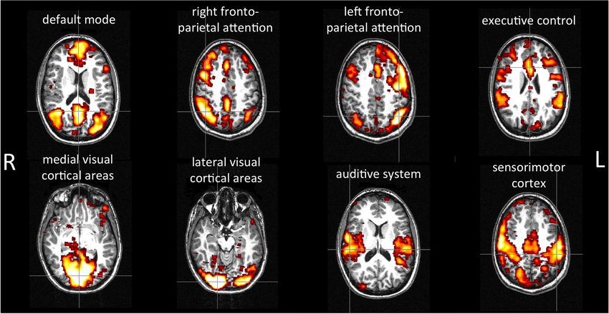
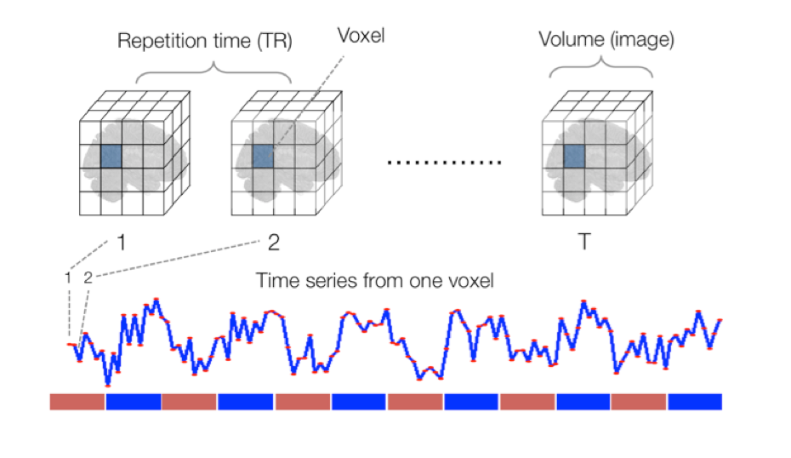
O que é a IRM funcional?
Técnica de imageamento não-invasivo e não ionizante.
Investigação da função cerebral associada aos diversos processos cognitivos e comportamentais.
Sequência de diversas imagens estáticas registradas ao longo do tempo -> séries temporais
Redes funcionais: conjunto de regiões coativadas devido a uma função, independentemente da existência de conexões estruturais.

Slide 4
Mecanismos físicos e biológicos
Blood-oxygen-level-dependent (BOLD)
➔ O aumento no fluxo sanguíneo produz um aumento na razão de hemoglobina oxigenada (diamagnética) em relação à hemoglobina desoxigenada (paramagnética).
➔ Ponderada em T2* (tempo de relaxação)
➔ Mede a atividade neuronal indiretamente
➔ Baixa resolução espacial e alta resolução temporal (comparando com outras técnicas de IRM)

Slide 5
Aplicações
Estudar a função cerebral durante diferentes tarefas cognitivas, como atenção, memória, tomada de decisão, processamento de linguagem e regulação emocional.
Investigar alterações cerebrais associadas a vários distúrbios neurológicos e psiquiátricos, como doença de Alzheimer, doença de Parkinson, esquizofrenia, depressão e ansiedade.
Identificar regiões cerebrais envolvidas em funções motoras específicas, como planejamento e execução de movimentos.
Mapeamento de redes cerebrais e padrões de conectividade associados a comportamentos, características ou distúrbios específicos.
Examinar os efeitos de intervenções, como drogas ou terapias comportamentais, na função e atividade cerebral.

Slide 6
Pré-processamento
Correção de tempo entre fatias
Correção de movimento da cabeça
Corregistro entre imagens funcionais e anatômicas
Filtragem temporal
Suavização espacial
Normalização
Segmentação
Remoção de ruídos e confundidores (denoising): SB, CSF, sinal global

Slide 7
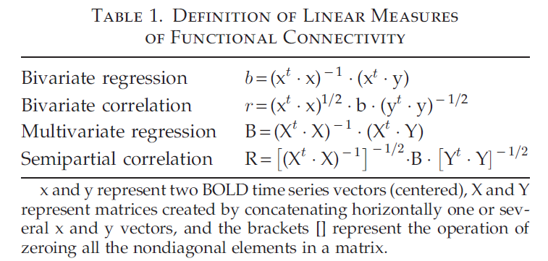
Métricas de Análise
Métricas Lineares (Seed-to-Voxel/ROI-to-ROI):
coeficientes de correlação e regressão bivariadas - Associação linear da série temporal BOLD entre pares de sementes.
Correlação semiparcial e Regressão multivariada - Contribuição de todas as sementes por um modelo linear geral.
Whitfield-Gabrieli and Nieto-Castanon - Conn: A Functional Connectivity Toolbox for Correlated and Anticorrelated Brain Networks (2012)

Slide 8
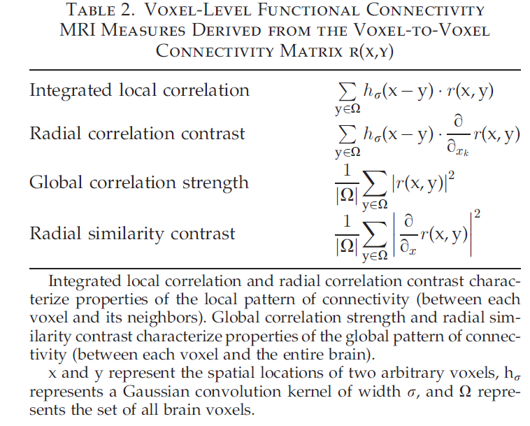
Métricas de Análise
Voxel-to-Voxel:
Correlação local integrada - Conectividade local média entre o voxel e seus vizinhos
Correlação local radial - Assimetria espacial do modelo de conectividade local (voxel > vizinhos)
Força de correlação global - Modelo de conectividade global (voxel > cérebro)
Contraste de similaridade radial - Similaridade global entre padrões de conectividade entre voxels vizinhos
Whitfield-Gabrieli and Nieto-Castanon - Conn: A Functional Connectivity Toolbox for Correlated and Anticorrelated Brain Networks (2012)

Slide 9
Second-level
Modelo linear geral - estimativas populacionais
Contrastes entre sujeitos (comparação entre grupos)
Contrastes ‘between-condition’ (comparação entre condições)
Contrastes ‘between-source’ (comparação entre sementes)
Combinação dos contrastes

Slide 10

HANDS-ON!

Slide 11
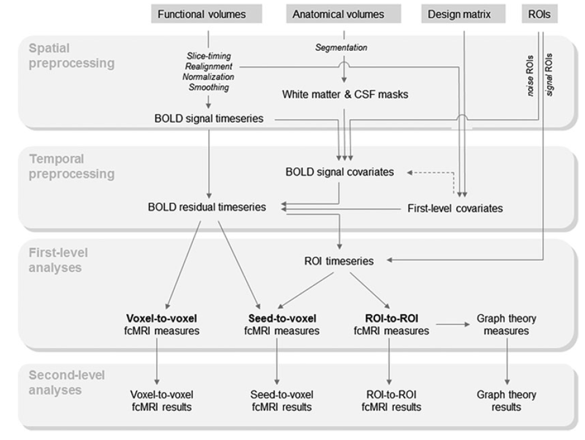
Apêndice
Whitfield-Gabrieli and Nieto-Castanon - Conn: A Functional Connectivity Toolbox for Correlated and Anticorrelated Brain Networks (2012)

Slide 12
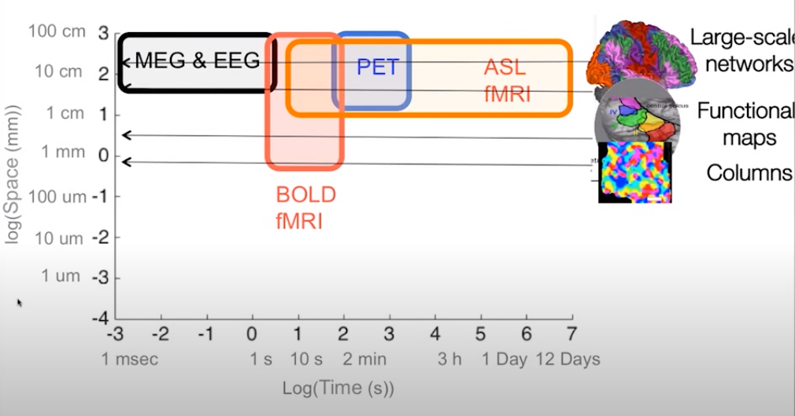
Apêndice

Slide 13
Links
https://andysbrainbook.readthedocs.io/en/latest/FunctionalConnectivity/CONN_Overview.html?highlight=conn - Andrew Jahn
https://web.conn-toolbox.org/ - Conn toolbox
Whitfield-Gabrieli S, Nieto-Castanon A. Conn: a functional connectivity toolbox for correlated and anticorrelated brain networks. Brain Connect. 2012;2(3):125-141. doi:10.1089/brain.2012.0073

Slide 14
Deep Learning for fMRI with PyTorch
Erick Almeida de Souza¹
¹Departamento de Física
Faculdade de Filosofia, Ciências e Letras de Ribeirão Preto (FFCLRP)
Universidade de São Paulo (USP)

Slide 15
Summary
Brief introduction to Deep Learning
General characteristics of my data
HANDS-ON with PyTorch:
How to create a dataset
How to replicate the neural network of “PREDICTION OF COGNITIVE SCORES AND GENDER CLASSIFICATION FROM DYNAMIC FUNCTIONAL CONNECTIVITY DERIVED FROM TASK-BASED MRI”
How to configure the model and implement training/testing
For future opportunities: Confounding removal, Stratified Cross-Validation, EarlyStopping…

Slide 16

Artificial Intelligence
https://medium.com/swlh/artificial-intelligence-machine-learning-and-deep-learning-whats-the-real-difference-94fe7e528097

Slide 17

Artificial Intelligence
Complex problems solving → Automatization
Machine Learning → learn from the data through mathematical operations → prediction in new data
LSTM, GAN, CNN → successful algorithms applied in medical images like fMRI
https://br.pinterest.com/pin/583497695447727488/

Slide 18
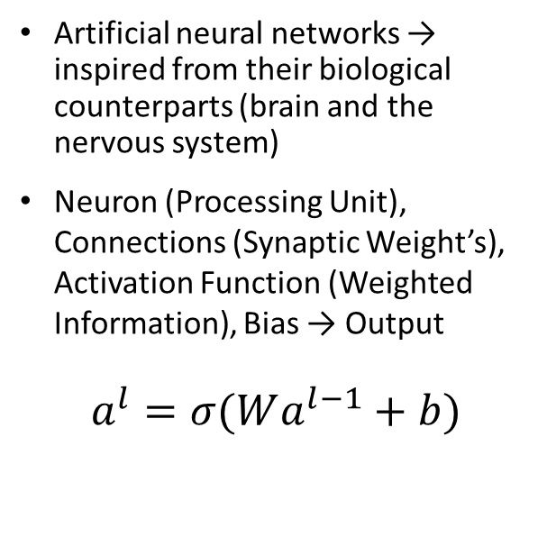
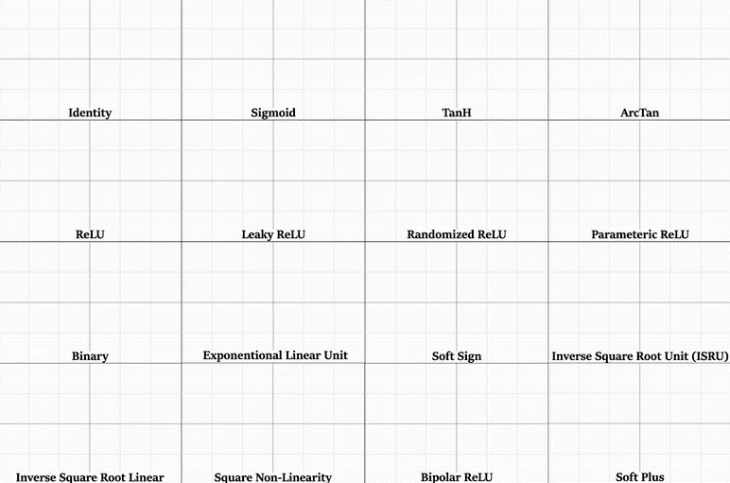
Artificial Intelligence

Slide 19
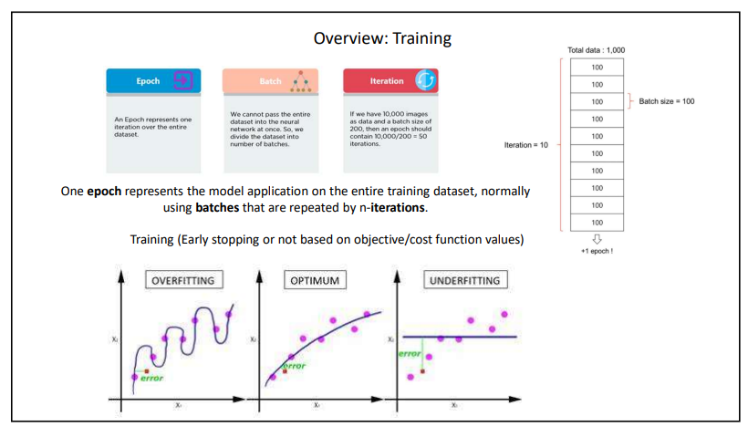
Artificial Intelligence

Slide 20
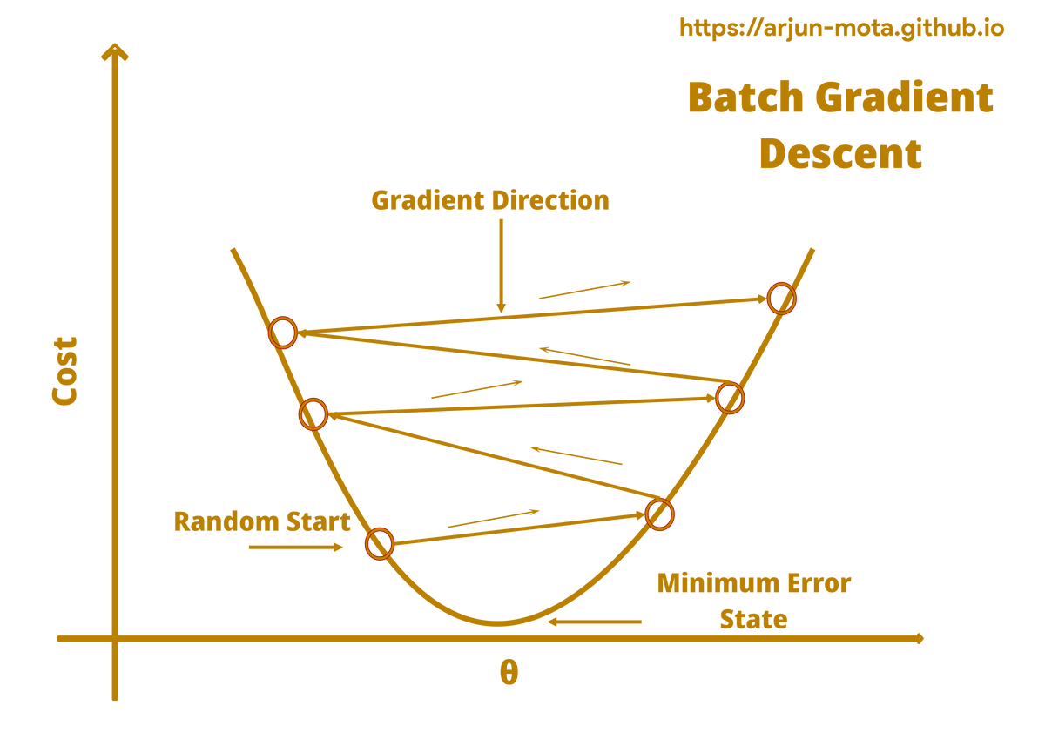
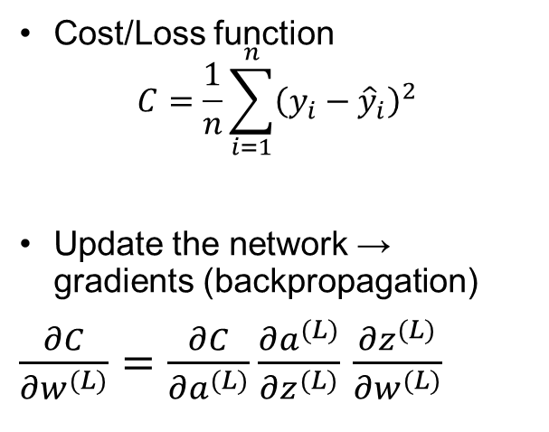
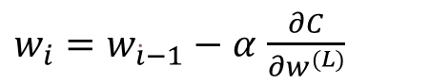
Artificial Intelligence

Slide 21
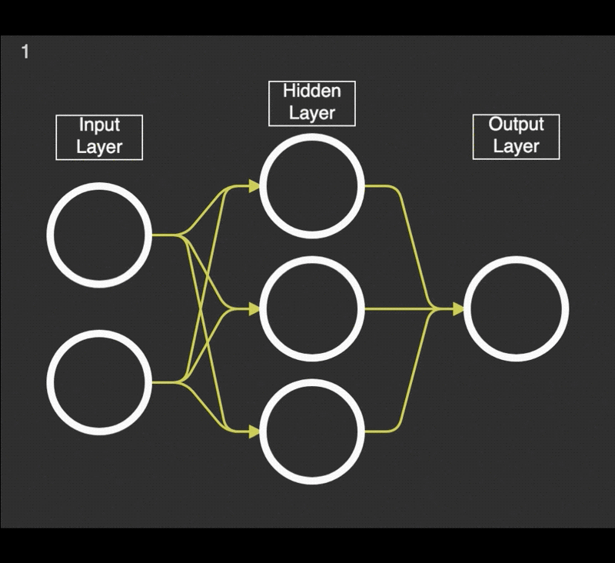
Artificial Intelligence
Neuron (Processing Unit)
Connections (Synaptic Weight’s)
Activation Function (Weighted Information)
Bias → Output
https://br.pinterest.com/pin/583497695447727488/

Slide 22
PREDICTION OF COGNITIVE SCORES AND GENDER CLASSIFICATION FROM DYNAMIC FUNCTIONAL CONNECTIVITY DERIVED FROM TASKBASED MRI
Dataset
Human Connectome Project (HCP) with N = 874 subjects
Minimal preprocessed data from WM and Language tfMRI
*(motion correction, B0 distortion correction, coregistration to T1-weighted images and normalization to surface template)
Neuropsychological data: Factor analysis applied on 10 cognitive tasks to derive the general factor g, using the omega function from psych package in R

Slide 23



PREDICTION OF COGNITIVE SCORES AND GENDER CLASSIFICATION FROM DYNAMIC FUNCTIONAL CONNECTIVITY DERIVED FROM TASKBASED MRI
Downloading images
ASPERA CONNECT

Slide 24

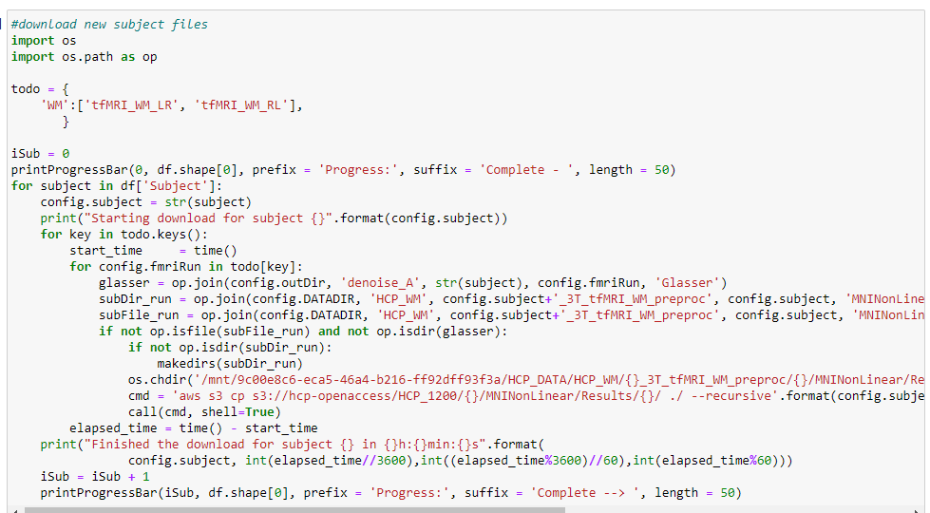
PREDICTION OF COGNITIVE SCORES AND GENDER CLASSIFICATION FROM DYNAMIC FUNCTIONAL CONNECTIVITY DERIVED FROM TASKBASED MRI
Downloading images

Slide 25
PREDICTION OF COGNITIVE SCORES AND GENDER CLASSIFICATION FROM DYNAMIC FUNCTIONAL CONNECTIVITY DERIVED FROM TASKBASED MRI
Parcellation scheme and pre-processing
Pre-processing pipeline (Dubois, 2018):
The signal at each voxel is z-score normalized.
Using tissue masks, temporal drifts from cerebrospinal fluid (CSF) and white matter (WM) are removed with third-degree Legendre polynomial regressors.
The mean signals of CSF and WM are computed and regressed from gray matter voxels.
Translational and rotational realignment parameters and their temporal derivatives are used as explanatory variables in motion regression.
Signals are lowpass filtered with a Gaussian kernel with a standard deviation of 1 TR, i.e. 720 ms in the HCP dataset.
The temporal drift from gray matter signal is removed using a third-degree Legendre polynomial regressor.
Global signal regression is performed.

Slide 26
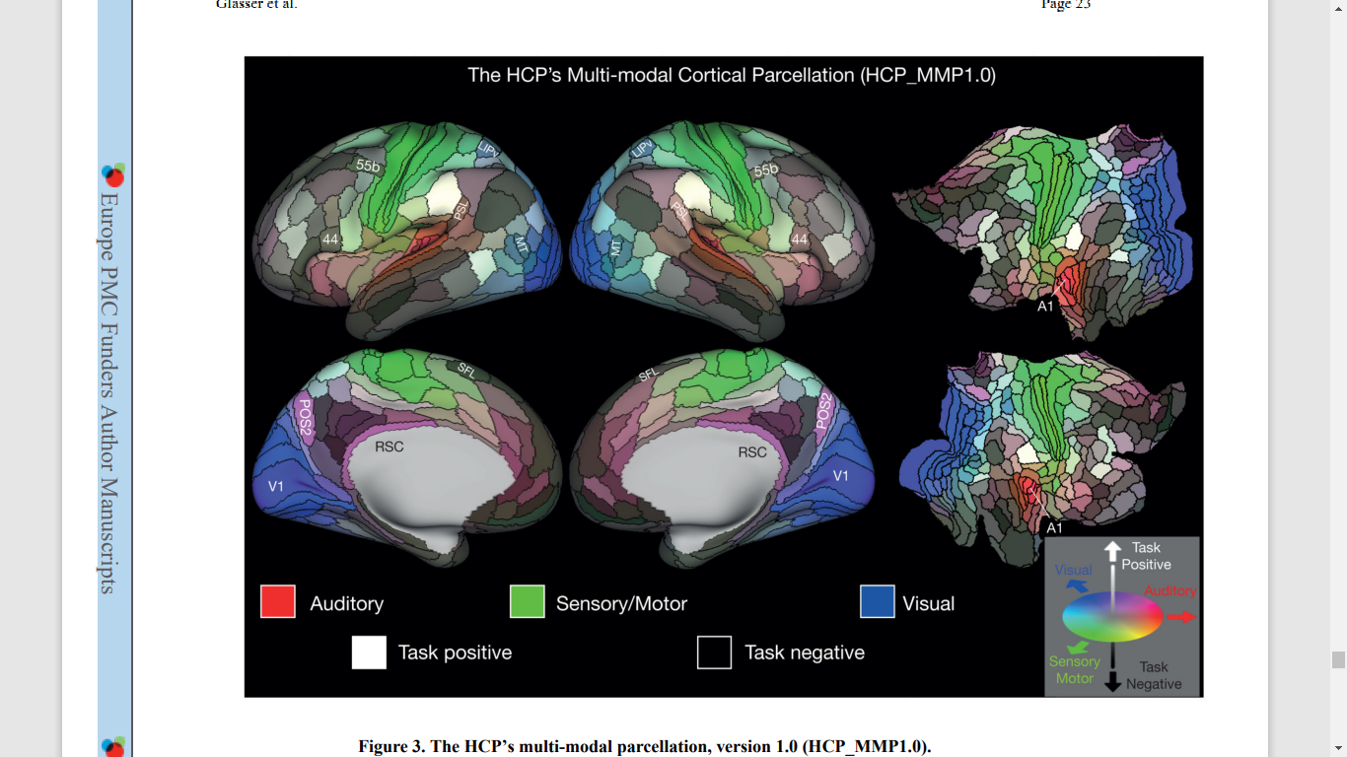
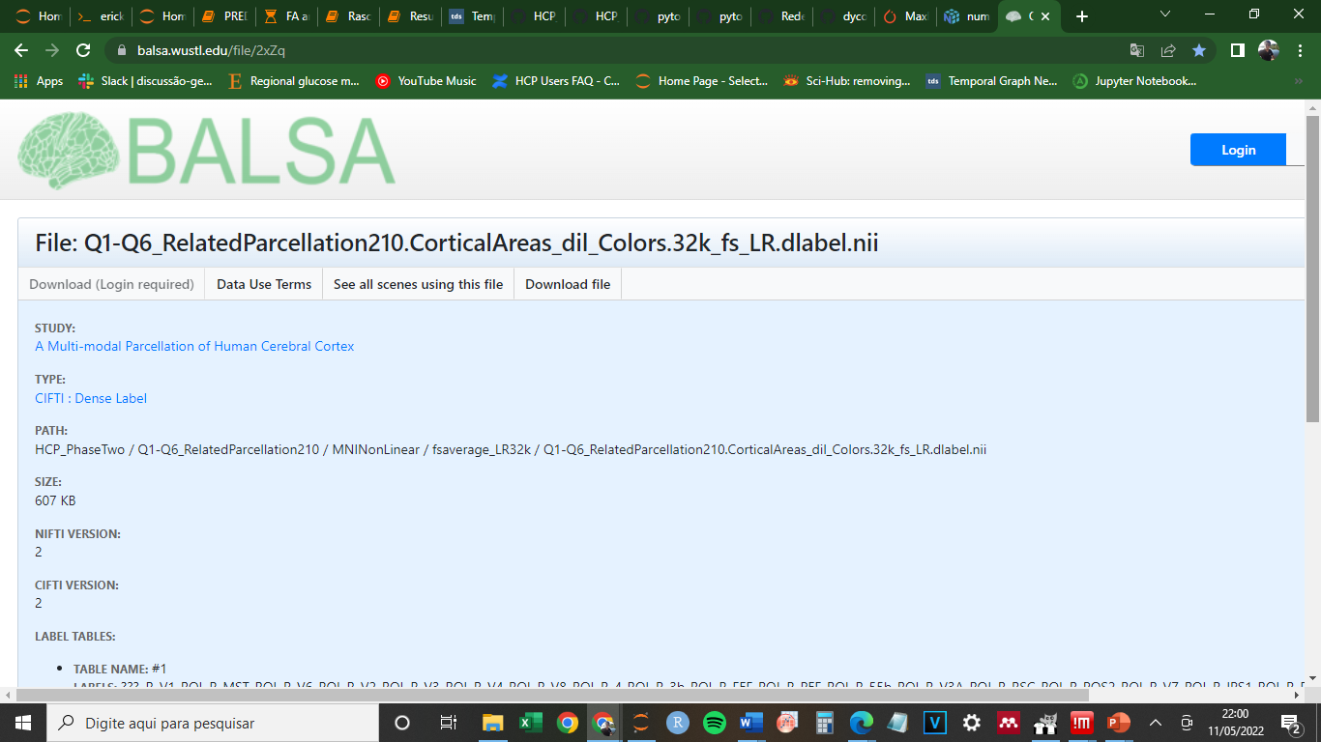
PREDICTION OF COGNITIVE SCORES AND GENDER CLASSIFICATION FROM DYNAMIC FUNCTIONAL CONNECTIVITY DERIVED FROM TASKBASED MRI
Parcellation scheme and pre-processing
Surface-based parcellation: 360 nodes; 180 for each hemisphere (Glasser)

Slide 27
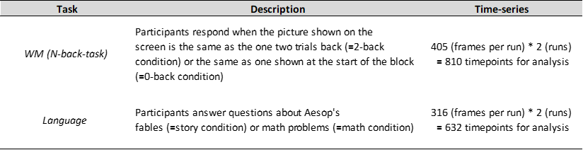
PREDICTION OF COGNITIVE SCORES AND GENDER CLASSIFICATION FROM DYNAMIC FUNCTIONAL CONNECTIVITY DERIVED FROM TASKBASED MRI
Task-fMRI in the HCP Dataset
Notes:
We chose faces, places, tools and body parts as the four categories of stimuli because of evidence that these stimuli reliably engage distinct cortical regions.
phase I of the HCP involved a broad array of pilot testing for pulse sequences, hardware, software and task paradigms (both in and out of the scanner). During this pilot testing, we optimized the length and design of the tasks, compared different paradigms for assessing similar functions and brain networks, and examined the degree of unique brain coverage provided by the different tasks.

Slide 28
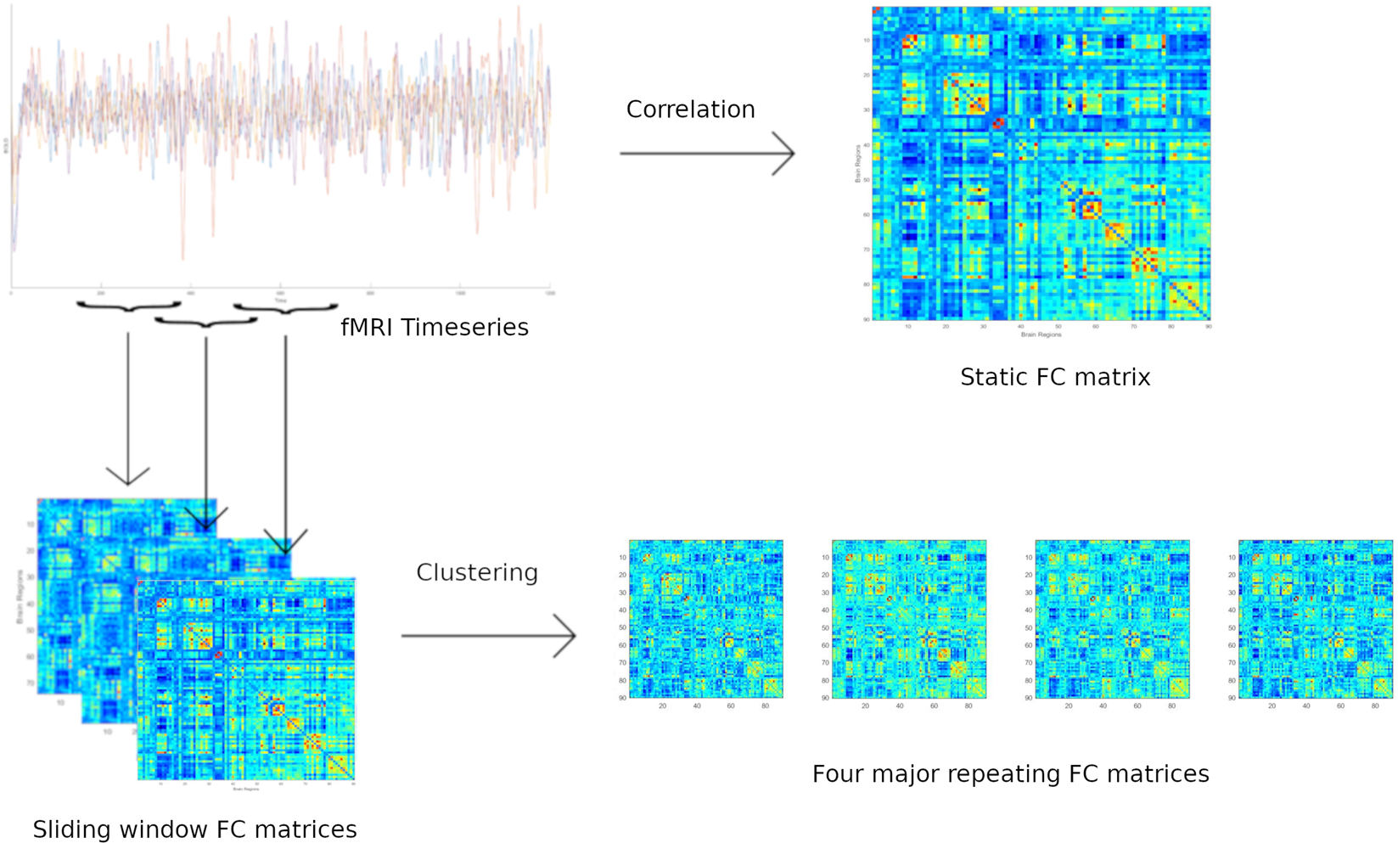
PREDICTION OF COGNITIVE SCORES AND GENDER CLASSIFICATION FROM DYNAMIC FUNCTIONAL CONNECTIVITY DERIVED FROM TASKBASED MRI
Dynamic functional connectivity
(Menon, 2019)
Notes:
https://www.nature.com/articles/s41598-019-42090-4

Slide 29
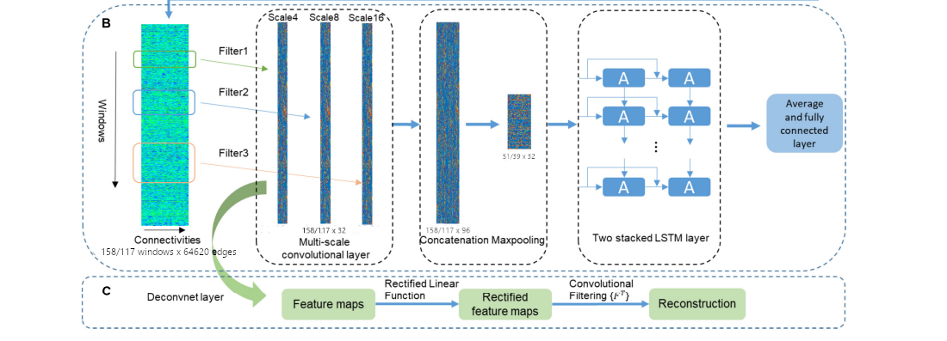
PREDICTION OF COGNITIVE SCORES AND GENDER CLASSIFICATION FROM DYNAMIC FUNCTIONAL CONNECTIVITY DERIVED FROM TASKBASED MRI
A Deep Network Model on Dynamic Functional Connectivity With Applications to Gender Classification and Intelligence Prediction (Fan L., 2020)
CNN + LSTM

Slide 30

PREDICTION OF COGNITIVE SCORES AND GENDER CLASSIFICATION FROM DYNAMIC FUNCTIONAL CONNECTIVITY DERIVED FROM TASKBASED MRI
Model
Training and testing parameters
10-fold cross-validation
Optimizer: Adam
Learning-rate: 0.0003 (weight decay rate of 0.5 after each 2 epochs)
Dropout: 0.5
Batch size: 64
Early stopping: when training loss continued to decrease but validation loss increased, this means that the training was already overfitting.

Slide 31
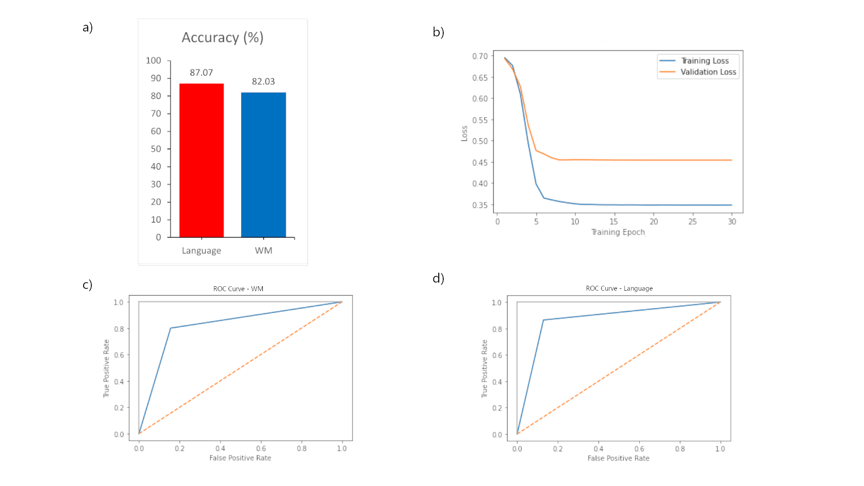
PREDICTION OF COGNITIVE SCORES AND GENDER CLASSIFICATION FROM DYNAMIC FUNCTIONAL CONNECTIVITY DERIVED FROM TASKBASED MRI
Results: Gender Classification
Fan et al. (2020) – 93,05% with rs-dFC

Slide 32
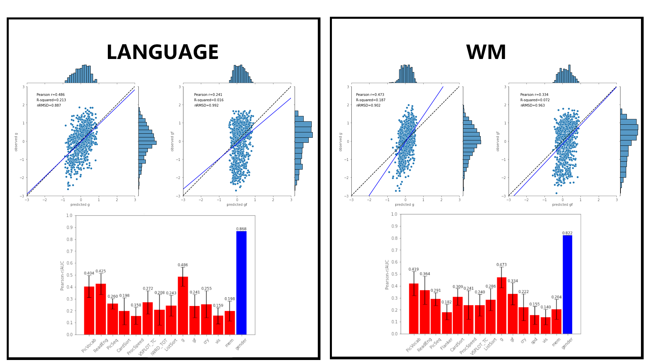
PREDICTION OF COGNITIVE SCORES AND GENDER CLASSIFICATION FROM DYNAMIC FUNCTIONAL CONNECTIVITY DERIVED FROM TASKBASED MRI
Results: Intelligence Prediction
*r = 0.367 ± 0.054 and 0.361 ± 0.087 for fluid intelligence

Slide 33
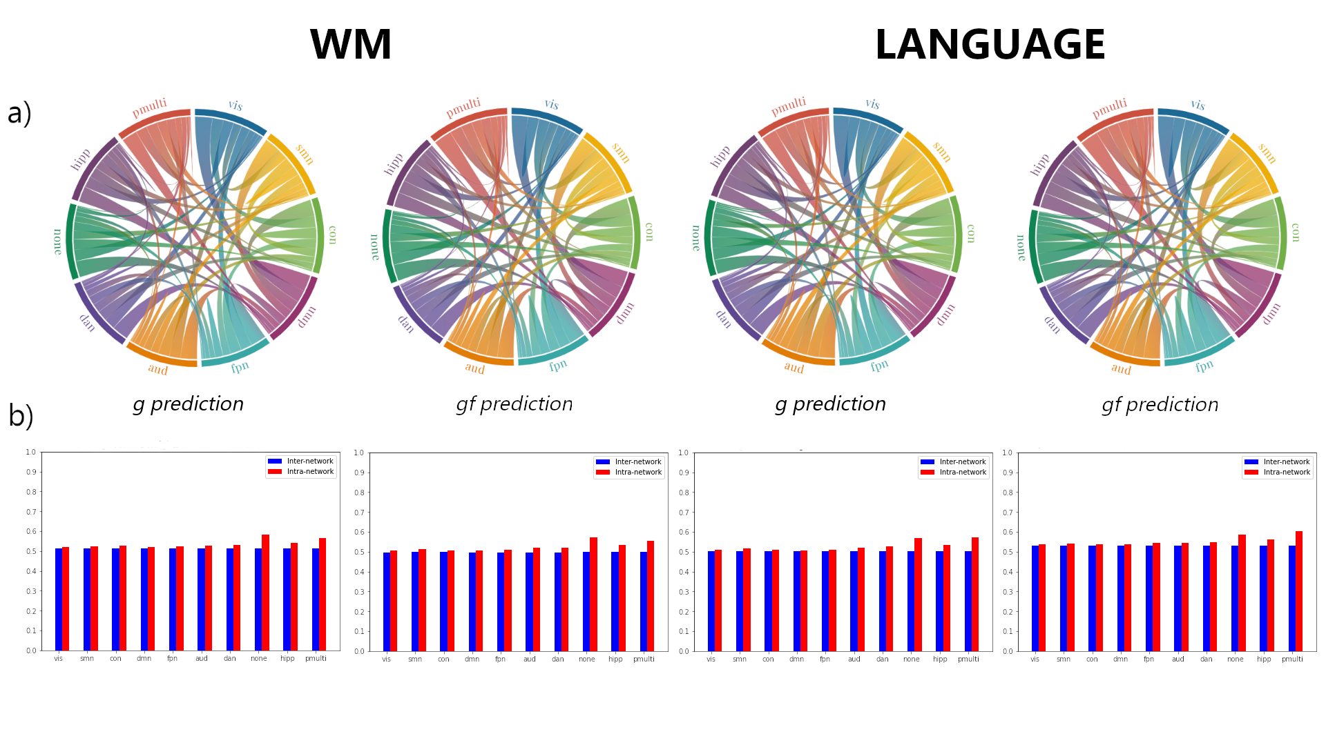
PREDICTION OF COGNITIVE SCORES AND GENDER CLASSIFICATION FROM DYNAMIC FUNCTIONAL CONNECTIVITY DERIVED FROM TASKBASED MRI
Results: Network Analysis

Slide 34
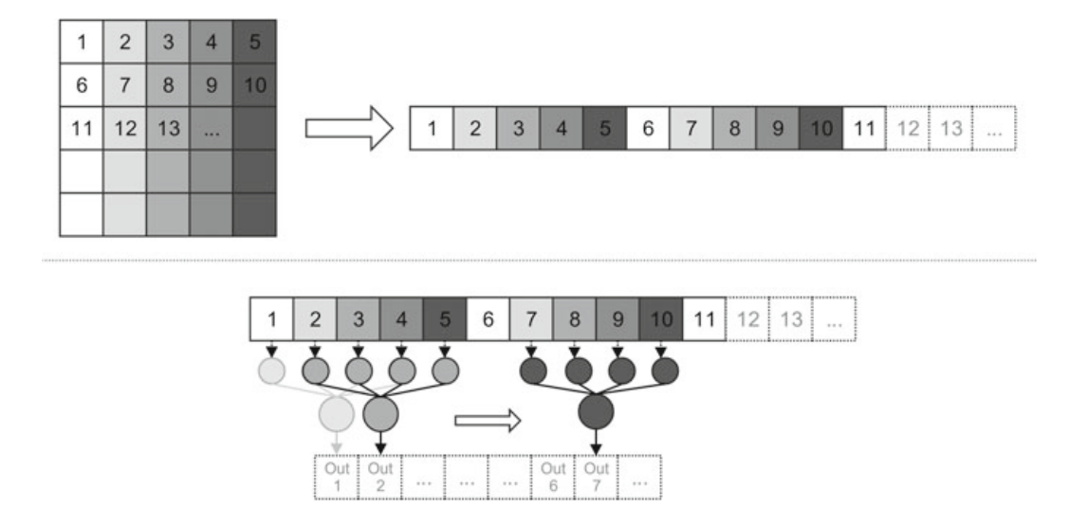
Appendix
CNN
Notes:
https://www.nature.com/articles/s41598-019-42090-4

Slide 35
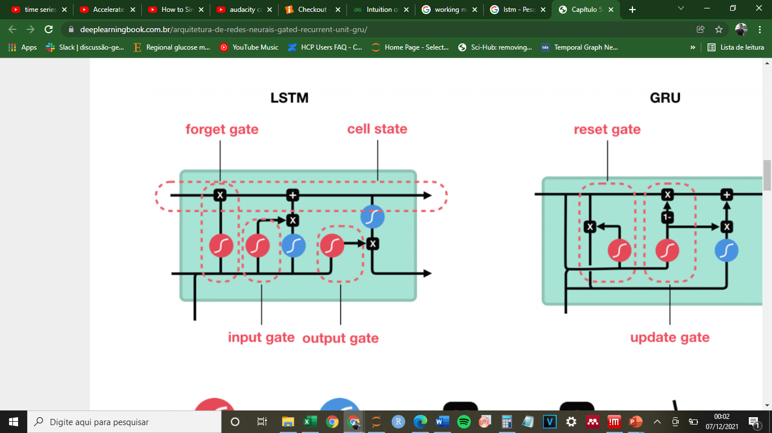
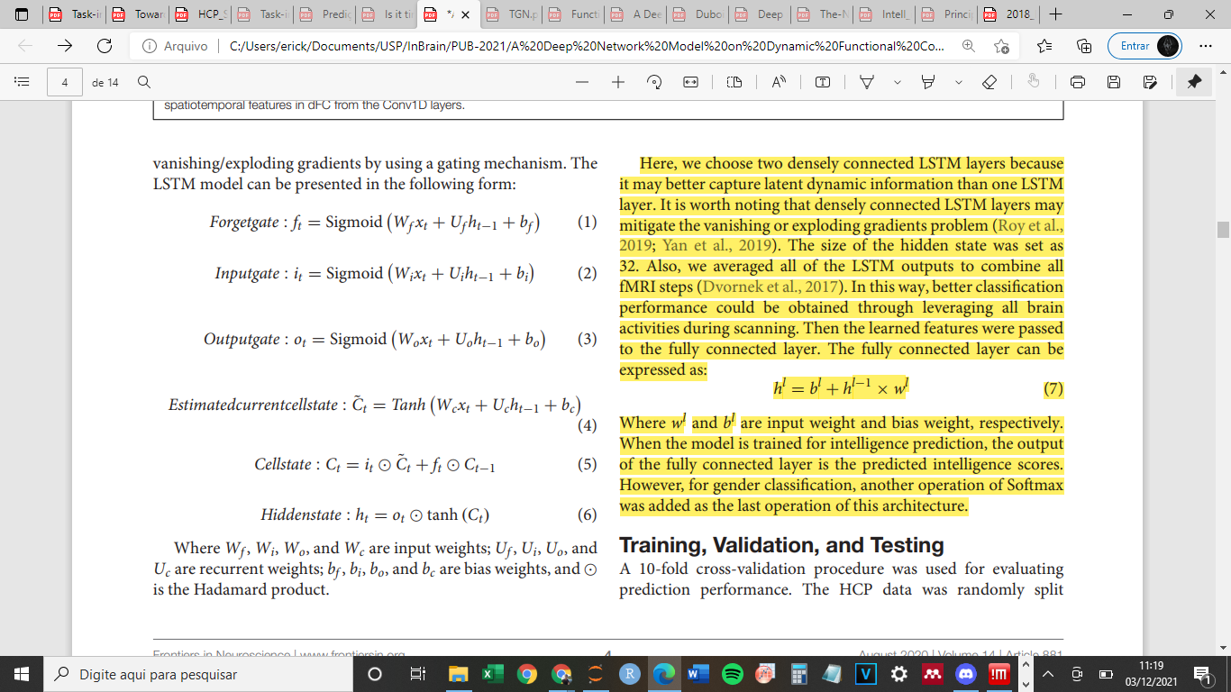
Appendix
LSTM (Long Short-Term Memory)
Notes:
https://www.nature.com/articles/s41598-019-42090-4

Slide 36
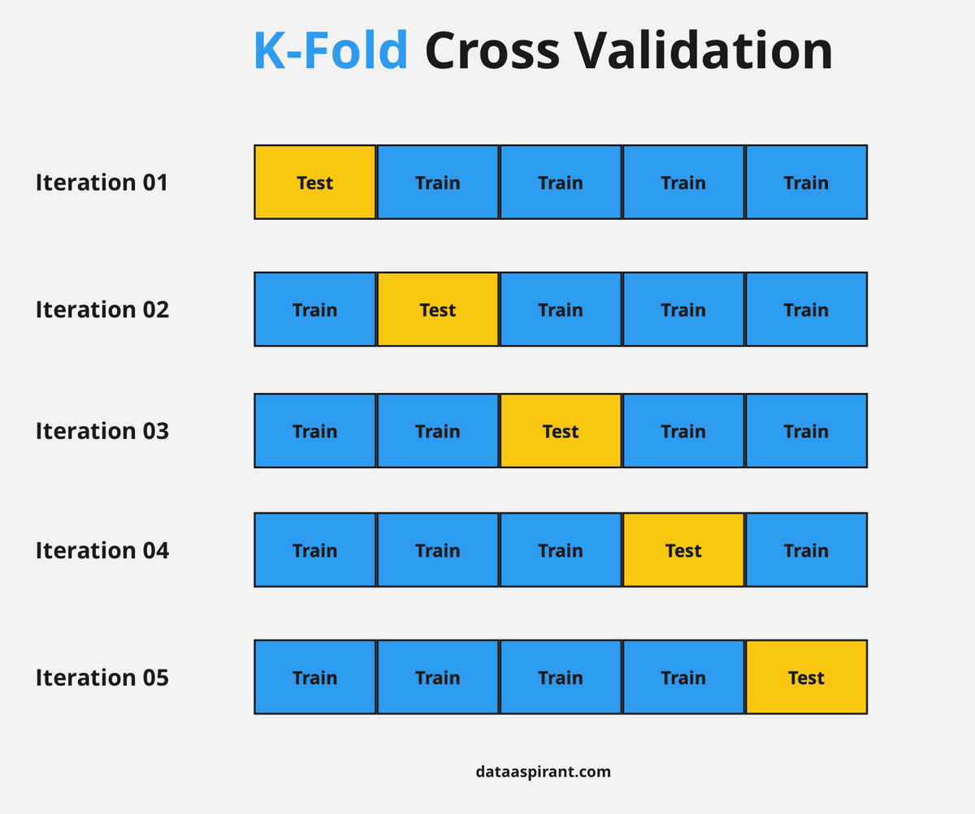
Appendix
K-fold Cross-validation
Notes:
https://www.nature.com/articles/s41598-019-42090-4

Slide 37
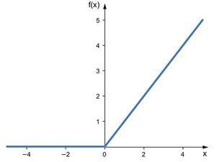
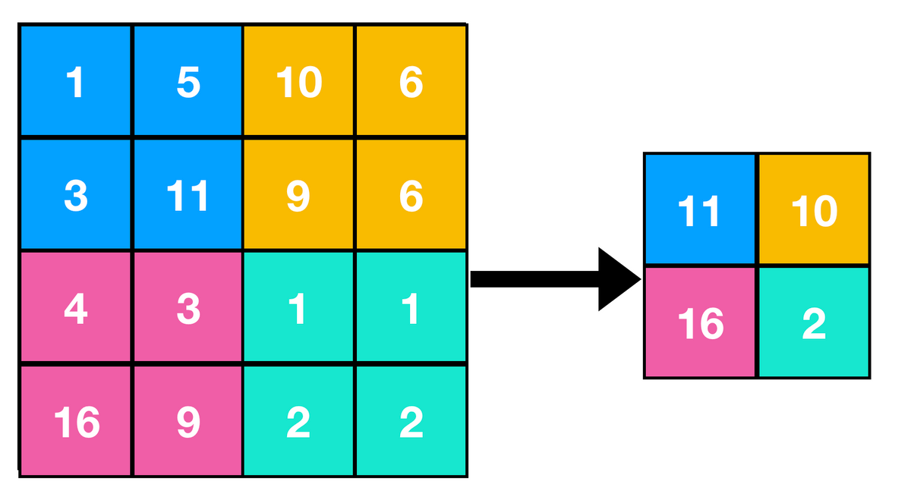
Appendix
ReLU (Rectified Linear Unit)
Max Pooling
Notes:
https://www.nature.com/articles/s41598-019-42090-4

Slide 38
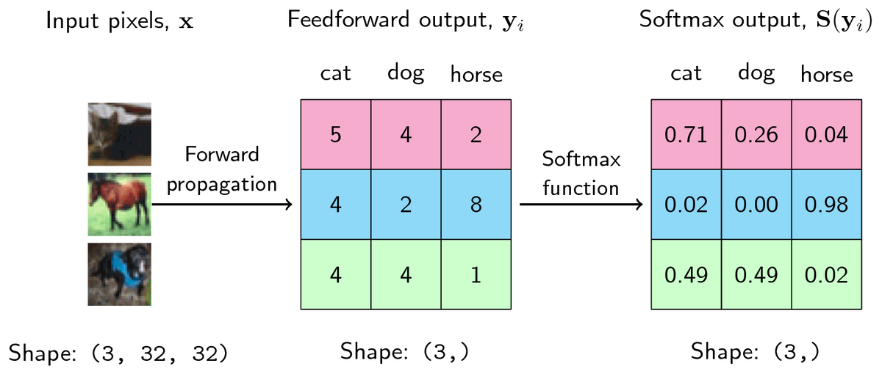
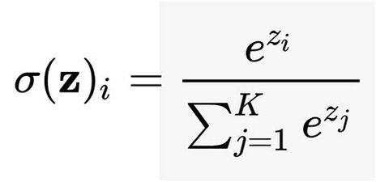
Appendix
SoftMax
Notes:
https://www.nature.com/articles/s41598-019-42090-4

Slide 39
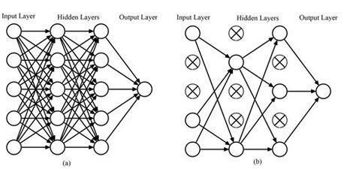
Appendix
Dropout
Notes:
https://www.nature.com/articles/s41598-019-42090-4

Slide 40
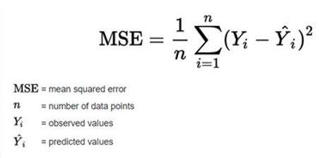
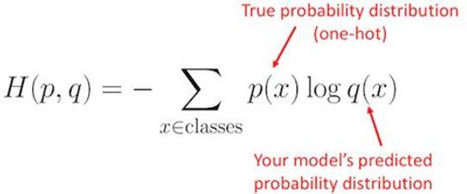
Appendix
Cross Entropy
Mean squared error
Notes:
https://www.nature.com/articles/s41598-019-42090-4

Slide 41
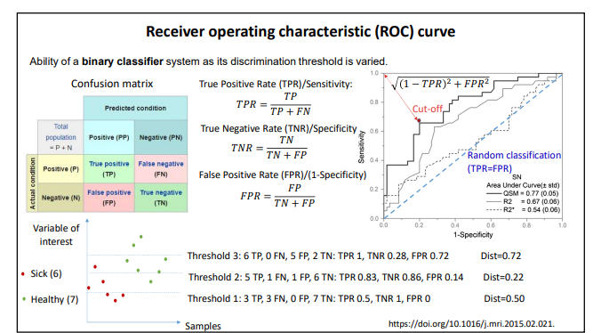
Appendix
ROC curve
Notes:
https://www.nature.com/articles/s41598-019-42090-4

Slide 42
www.inbrainlab.com
OBRIGADO/THANK YOU!!
e-mail: erick_almeida@usp.br

